Slide 1
Linking Biological Data with Modeling and Simulation Bioinformatics Student Symposium
.
Sparisoma Viridi
Master Program in Computational Science, Nuclear Physics and Biophysics Research Division,
Department of Physics, Faculty of Mathematics and Natural Sciences, Institut Teknologi Bandung,
Bandung 40132, Indonesia
20230522_v5| https://doi.org/10.5281/zenodo.7955393

Slide 2
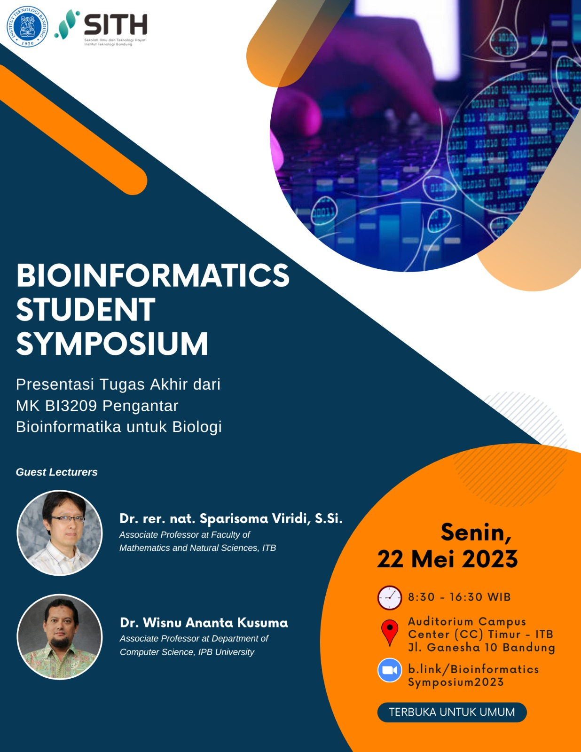

Slide 3
Silakan berdiskusi asinkron setelah simposium ini di https://github.com/dudung/bi3209-00-2022-2/issues/1

Slide 4
Keterangan (disclaimer)
Apa yang akan disampaikan tidak terkait langsung dengan bidang bioinformatika, akan tetapi lebih merupakan sharing pengalaman penelitian selama ini.
Rujukan, yang telah dipilih, mengenai suatu hal dituliskan di bagian bawah slide terkait untuk dapat ditelusuri lebih lanjut.
Hal-hal yang disampaikan tidak dapat terlepas dari pendapat pribadi dan pengalaman penyaji, sehingga belum tentu meru-pakan informasi yang paling tepat.

Slide 5
Kerangka
Model 6
Simulasi 14
Akurasi dan keseder- hanaan 22
Bioinformatika 32
Fiksi atau impian? 36
Penelitian (penyaji) saat ini 39
Diskusi –3

Slide 6
Model

Slide 7
Model
A model is a product (physical or digital) that represents a system of interest.
A model is similar to but simpler than the system it represents, while approximating most of the same salient features of the real system as close as possible.
A good model is a judicious tradeoff between realism and simplicity.
Vinod Kumar Soni, “Answer to What is the difference between simulation and modeling?”, ResearchGate, 21 Feb 2020, url https://www.researchgate.net/post/What_is_the_difference_between_simulation_and_modeling [20230519].

Slide 8
Model (lanj.)
A key feature of a model is manipulability.
A model can be:
a physical model (for example a physical architectural house scale model, a model aircraft, a fashion mannequin, or a model organism in biology research); or
a conceptual model (for example a computer model, a statistical or mathematical model, a business model).

Slide 9
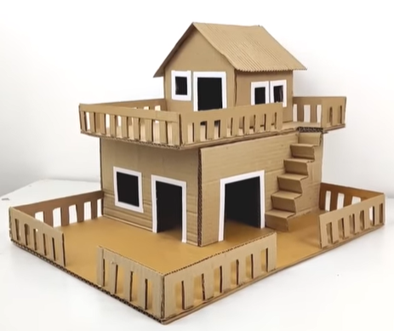
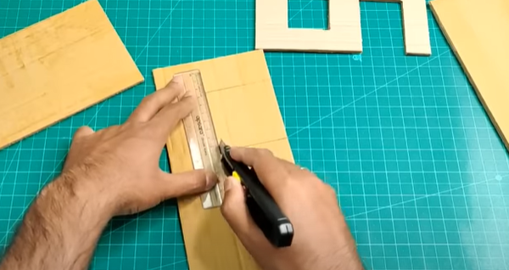
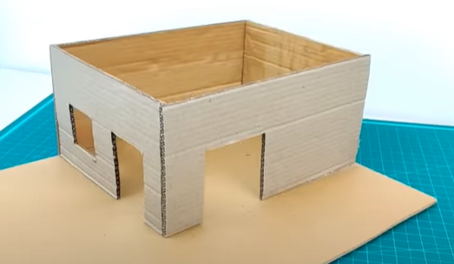
Aman Crafts, “Cardboard House Model Making | How To Make Miniature House From Cardboard | Cardboard House Project”, YouTube, 10.04.2022, url https://www.youtube.com/watch?v=_PvjdZIbgVg [20230519].

Slide 10
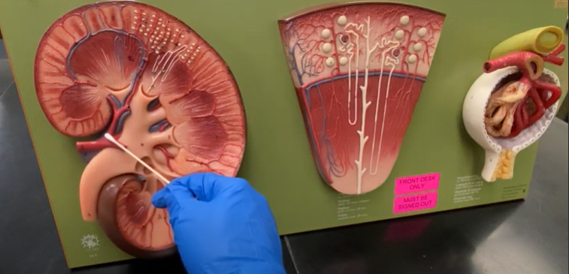
Dr. Denny Patel, DPT, CSCS Anatomy Lessons, “Kidney Model”, YouTube, 19.11.2020, url https://www.youtube.com/watch?v=YDfwdxw1NZE [20230519].

Slide 11
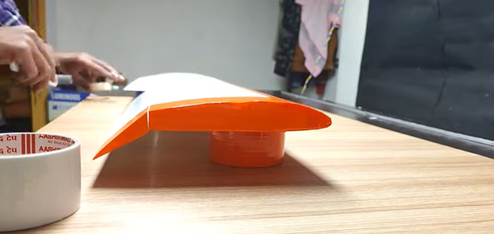
INDI RC, “How to make Wing for RC plane @INDIRC1”, YouTube, 31.12.2021, url https://www.youtube.com/watch?v=R1jRXSe3970 [20230519].

Slide 12
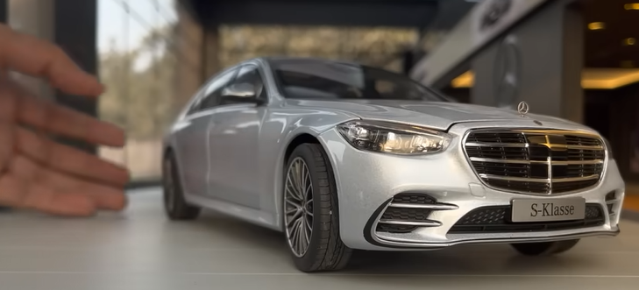
IMiniature Automobiles, “Mega Mercedes-Benz Car Collection 1:18 Scale | Mercedes Dealership Diorama | Diecast Model Cars”, YouTube, 27.12.2022, url https://www.youtube.com/watch?v=d1YM9vEjo6c [20230522].

Slide 13
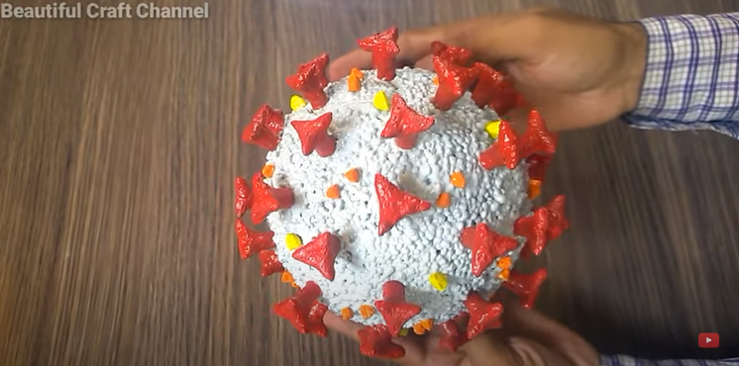
Beautiful Craft, "How to make coronavirus 3d model Craft | Coronavirus model Diy (covid-19)" YouTube, 28.06.2020,
url https://www.youtube.com/watch?v=yNsfpIW7mJo [20230522].

Slide 14
Simulasi

Slide 15
Simulation
A simulation is the process of using a model to study the behavior and performance of an actual or theoretical system.
In a simulation, models can be used to study existing or proposed characteristics of a system.
The purpose of a simulation is to study the characteristics of a real-life or fictional system by manipulating variables that cannot be controlled in a real system.
Vinod Kumar Soni, “Answer to What is the difference between simulation and modeling?”, ResearchGate, 21 Feb 2020, url https://www.researchgate.net/post/What_is_the_difference_between_simulation_and_modeling [20230519].

Slide 16
Simulation (lanj.)
Simulations allow evaluating a model to optimize system performance or to make predictions about a real system.
Simulations are useful to study properties of a model of a real-life system that would otherwise be too complex, too large/small, too fast/slow, not accessible, too dangerous or unacceptable to engage.
While a model aims to be true to the system it represents, a simulation can use a model to explore states that would not be possible in the original system.

Slide 17
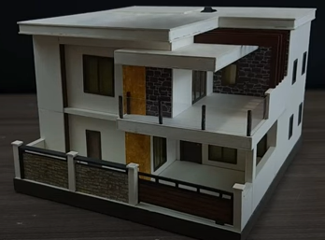
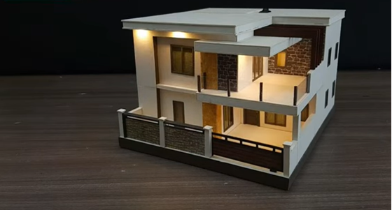
Dimetrius Darwin, “Anleitung zur Herstellung eines Miniaturhauses mit LED-Licht | Maßstab 1/64”, YouTube, 04.03.2022, url https://www.youtube.com/watch?v=US5tpFVJqvY [20230519].

Slide 18
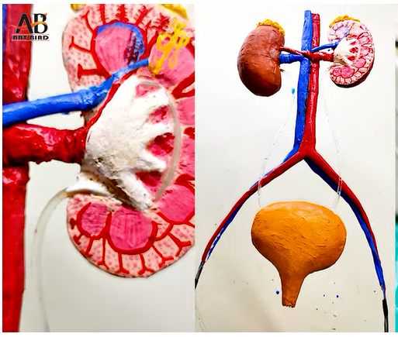
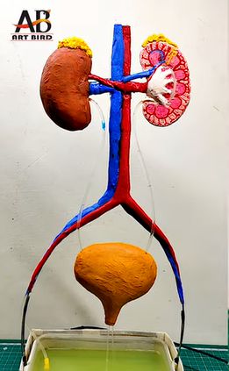
Art Bird, “How to make kidney working model”, YouTube, 17.09.2021, url https://www.youtube.com/watch?v=Q5Qtfj1GOuI [20230522].

Slide 19
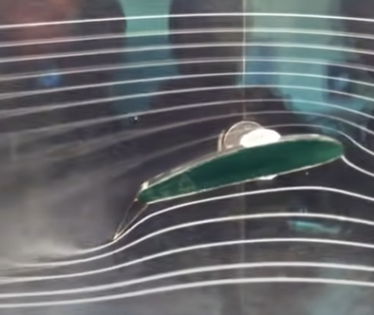
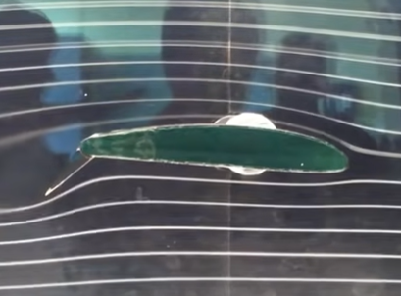
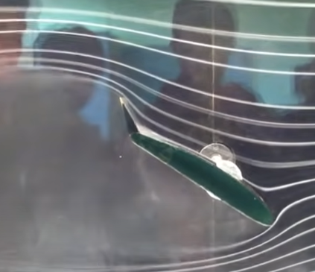
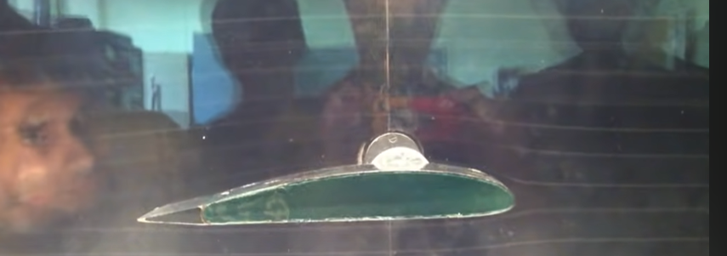
Ruhou Gao, “Cambered Airfoil in Smoke Tunnel”, YouTube, 15.09.2012, url https://www.youtube.com/watch?v=Png0fnG0b_U [20230519].

Slide 20
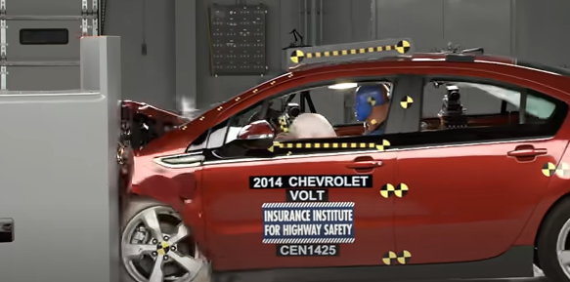
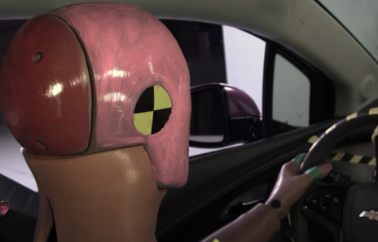
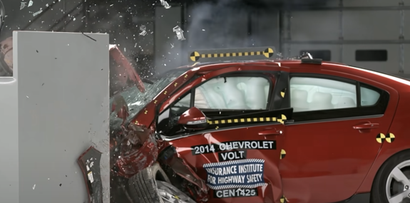
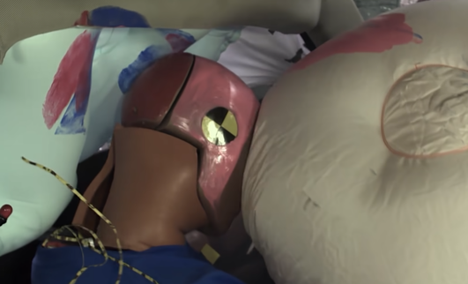
Canale25, “Car Crash & Accidents Tests - Chevrolet Nissan Mazda Fiat & More”, YouTube, 31.07.2014, url https://www.youtube.com/watch?v=3nGX44oRiTE [20230519].

Slide 21
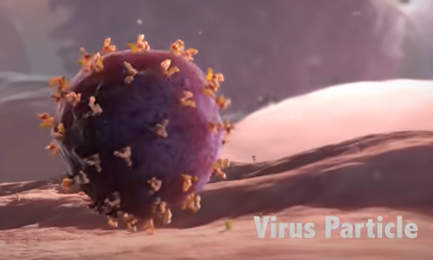
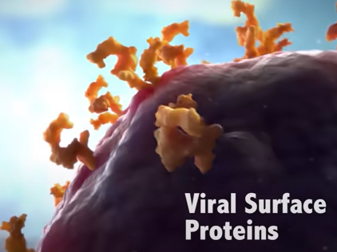
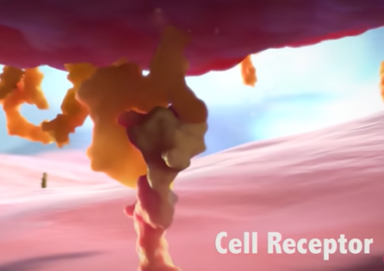
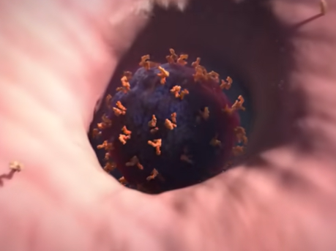
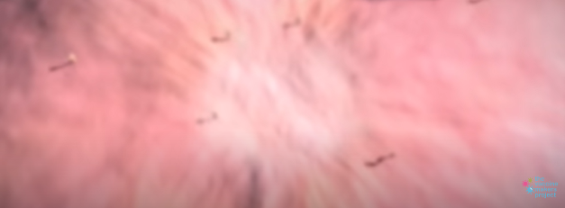
Vaccine Makers Project, "A Virus Attacks a Cell" YouTube, 28.07.2017, url https://www.youtube.com/watch?v=jkNxmTrrZSk [20230519].

Slide 22
Akurasi dan kesederhanaan

Slide 23
Accuracy vs simplicity
Accuracy vs. Simplicity: A Complex Trade-Off (E. Aragones, I. Gilboa, A. Postlewatite, D. Schmeidler, 2002).
Simplicity and Accuracy Trade-Off in Science: Simple metric for model selection (P. Niinen, 2013).
An Analysis of Accuracy and Simplicity in Relation to Knowledge (Kibin, 2023).
Simplicity vs Complexity in Machine Learning — Finding the Right Balance (Tayo, 2019).
pdf
pdf
html
html

Slide 24
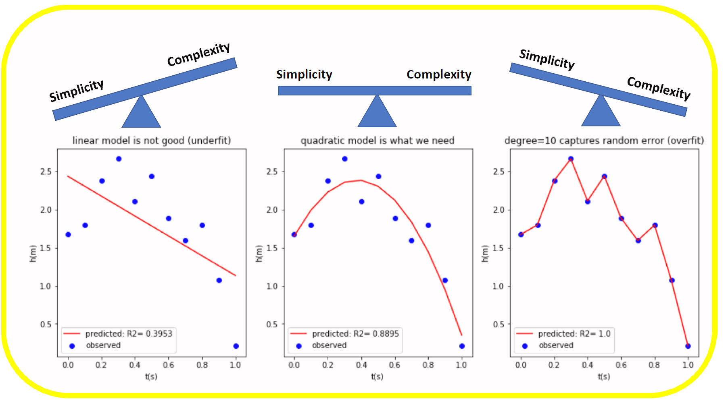
Benjamin Obi Tayo, “Simplicity vs Complexity in Machine Learning — Finding the Right Balance”, Towards Data Science, 11 Nov 2019, url https://towardsdatascience.com/p-c9000d1726fb [20230519].

Slide 25
Simple model is preferred over a complex one
Prevents Overfitting: A high-dimensional dataset having too many features can sometimes lead to overfitting (model captures both real and random effects).
Interpretability: An over-complex model having too many features can be hard to interpret especially when features are correlated with each other.
Computational Efficiency: A model trained on a lower-dimensional dataset is computationally efficient (execution of algorithm requires less computational time).

Slide 26
Gerak parabola
Materi fisika dasar yang banyak dimanfaatkan, terutama dalam perang (sains tidak berpihak, tergantung yang memanfaatkanya ☹).
Dapat ditingkatkan kompleksitasnya dengan menambahkan gesekan udara dan adanya angin yang berubah-ubah arah dan besarnya.
Ilustrasi yang digunakan masih tanpa angin dan tanpa gesekan udara.

Slide 30
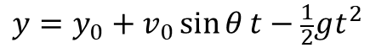
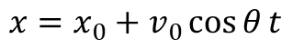
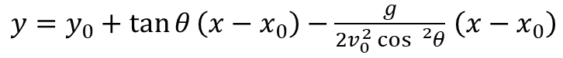
Formula
Fungsi parametrik (dari kinematika)
Posisi vertikal sebagai fungsi posisi horizontal
$$x=x_{0}+v_{0}\cos{θ}t$$
$$y=y_{0}+v_{0}\sin{θ}t−\frac{1}{2}gt^{2}$$
$y=y_{0}+\tan{θ}\left(x−x_{0}\right)−\frac{g}{2v_{0}^{2}\cos{{}_{}^{2}θ}}$ $\left(x−x_{0}\right)$

Slide 31
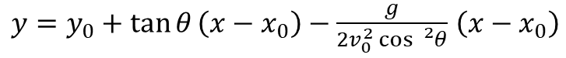
$y=y_{0}+\tan{θ}\left(x−x_{0}\right)−\frac{g}{2v_{0}^{2}\cos{{}_{}^{2}θ}}$ $\left(x−x_{0}\right)$

Slide 32
Bioinformatika

Slide 33
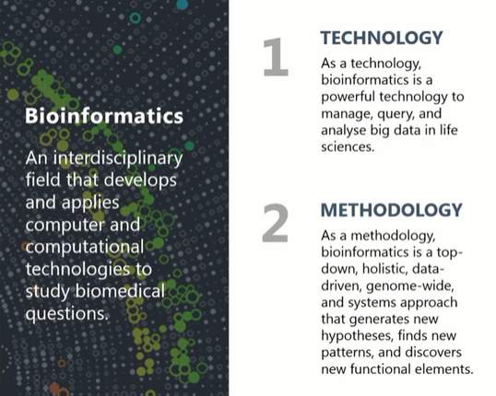
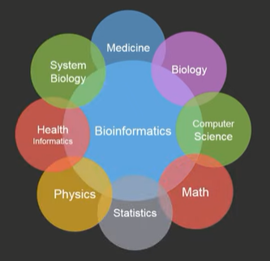
Precision Health, "What is Bioinformatics?" YouTube, 14.05.2021, url https://www.youtube.com/watch?v=7j3atzpjh2c [20230522].

Slide 34
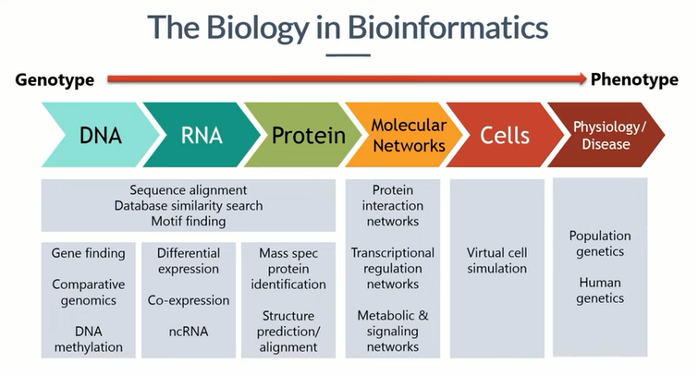

Slide 35
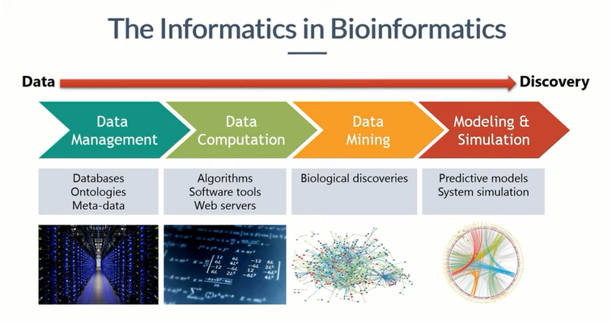

Slide 36
Fiksi atau impian?

Slide 37
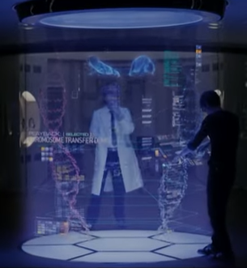
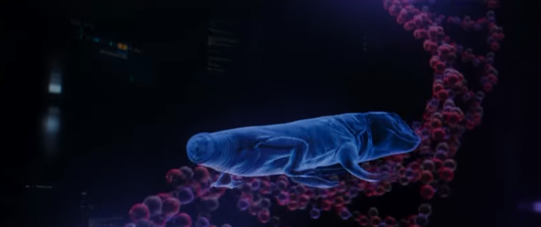
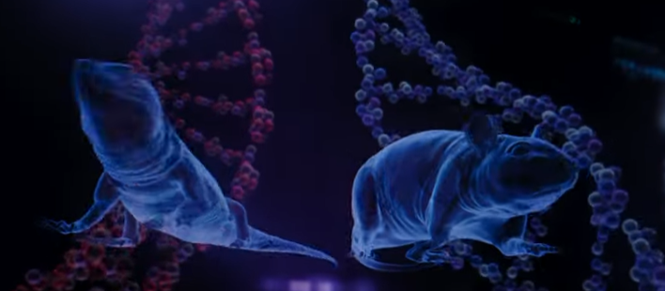
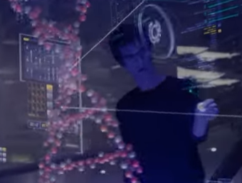
NOW PLAYING, "The Amazing Spider Man | Lizard Mouse" YouTube, 14.05.2021, url https://www.youtube.com/watch?v=eqtg_2ePb7o [20230522].

Slide 38
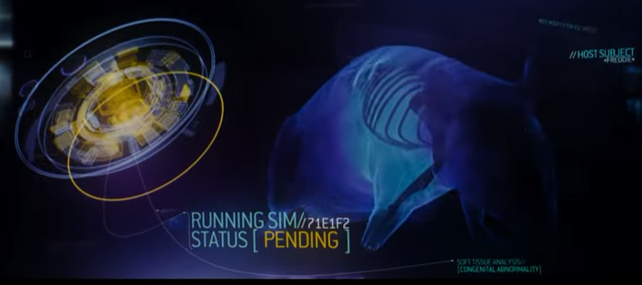
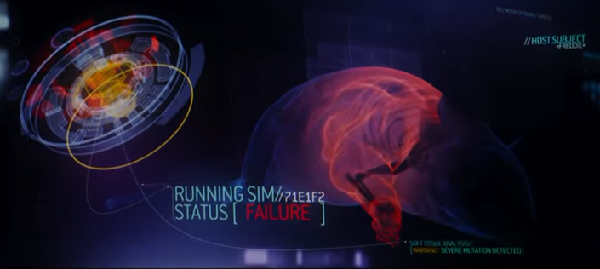
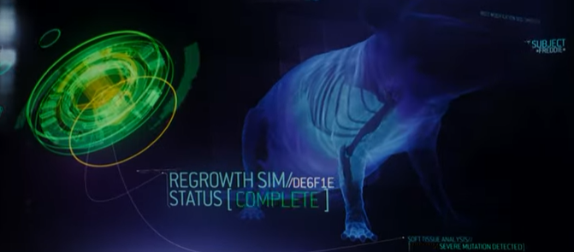
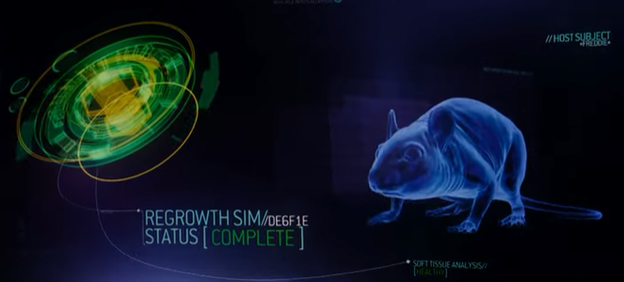

Slide 39
Penelitian (penyaji) saat ini

Slide 40
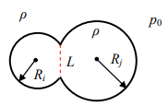
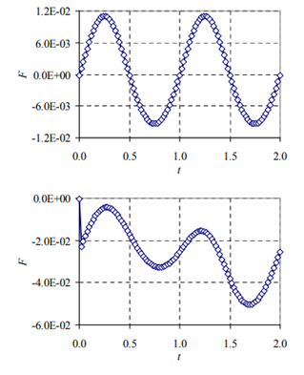
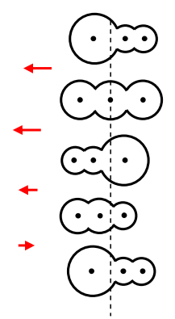
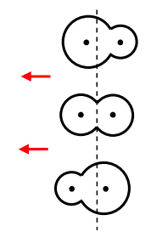
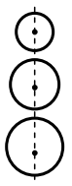
S. Viridi, N. Nuraini, "Self-Motion Mechanism of Chained Spherical Grains Cells", in Symposium on Biomathematics-2013, edited by H. Arimura et al., AIP Conference Proceedings 1587, American Institute of Physics, Melville, NY, 2014, pp. 123-126.

Slide 41
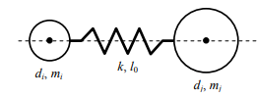
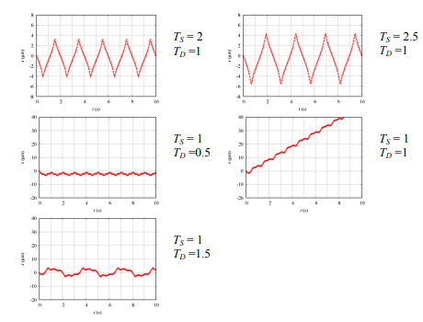
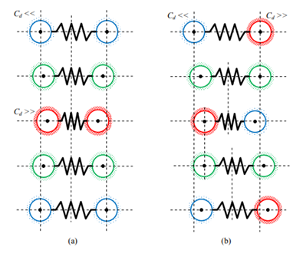
S. Viridi, N. Nuraini, "Simulation of Single Microorganism Motion in Fluid based on Granular Model", in Symposium on Biomathematics-2015, edited by Y. Takeuchi and M. Apri, AIP Conference Proceedings 1723, American Institute of Physics, Melville, NY, 2016, pp. 030022.

Slide 42



N. Nuraini, S. Viridi, F. Haryanto, S. N. Khotimah, "Molecular Dynamics Simulation of Microorganism Motion in Fluid Based on Granular Model in the Case of Multiple Simple Push-Pull filaments", in Symposium on Biomathematics-2016, edited by B. Benyamin and Kasbawati, AIP Conference Proceedings 1825, American Institute of Physics, Melville, NY, 2017, pp. 020016.

Slide 43


Armi Susandi, Intan Taufik, Pingkan Aditiawati, Sparisoma Viridi, "The relation between agent-based model and susceptible-infected-recovered model for spread of disease", in The 9th National Physics Seminar, (SNF)-2020, edited by Hadi Nasbey, Riser Fahdiran, Widyaningrum Indrasari, Esmar Budi, Fauzi Bakri, Teguh Budi Prayitno, Dewi Muliyati, AIP Conference Proceedings 2320, American Institute of Physics, Melville, NY, 2021, pp. 050032.

Slide 44

Catatan
Simulasi sistem biologi yang telah dilakukan terkait kedinamis-an biopartikel, baik berupa mikroorganisme ataupun orang.
Ranah ini merupakan ujung akhir dari Bioinformatika.
Perlu kolaborasi dan model yang lebih mendalam agar dapat mengaitkan gerak biopartikel dengan informasi genomik.

Slide 45
Diskusi

Slide 46
Saran dan pertanyaan
Silakan menyampaikan saran dan mengajukan pertanyaan.
Mari kita berdiskusi.

Slide 47
Terima kasih

